Slide 1
L4 Networks

Slide 2
Ports, Services, and Hosts
Services running on a host bind to a port, and use that port as a means of data transmission, which looks like slightly fancy file writing in Linux
Ports allow us to run many services off the same IP, so 192.168.1.5:80 would handle all the HTTP traffic for the host at 192.168.1.5
Well known (and permissions regulated) ports are 0 < x <= 1024
The rest of the port range (1025 < x <= 65535) is open and available
Here are a few well known ports you should be familiar with
80/443 | 22 | 25 | 52 | 389 | 994 | 873
HTTP | SSH/SFTP | SMTP | DNS/DHCP | LDAP | NFS | rsync

Slide 3
Segment Protocols
Application data sent to a port for transmission is converted into a segment
Segments are then handled primarily through one of two protocols
User Datagram Protocol (UDP)
Connectionaless, unreliable, “send and forget” style of segment transmission over a network
Only adds multiplexing and demultiplexing capabilities to the system
Transmission Control Protocol (TCP)
Connection oriented, reliable protocol which uses acknowledgements to “guarantee” delivery to the recipient
Adds congestion avoidance, flow control, and out of order delivery as well as multiplexing and demultiplexing

Slide 4
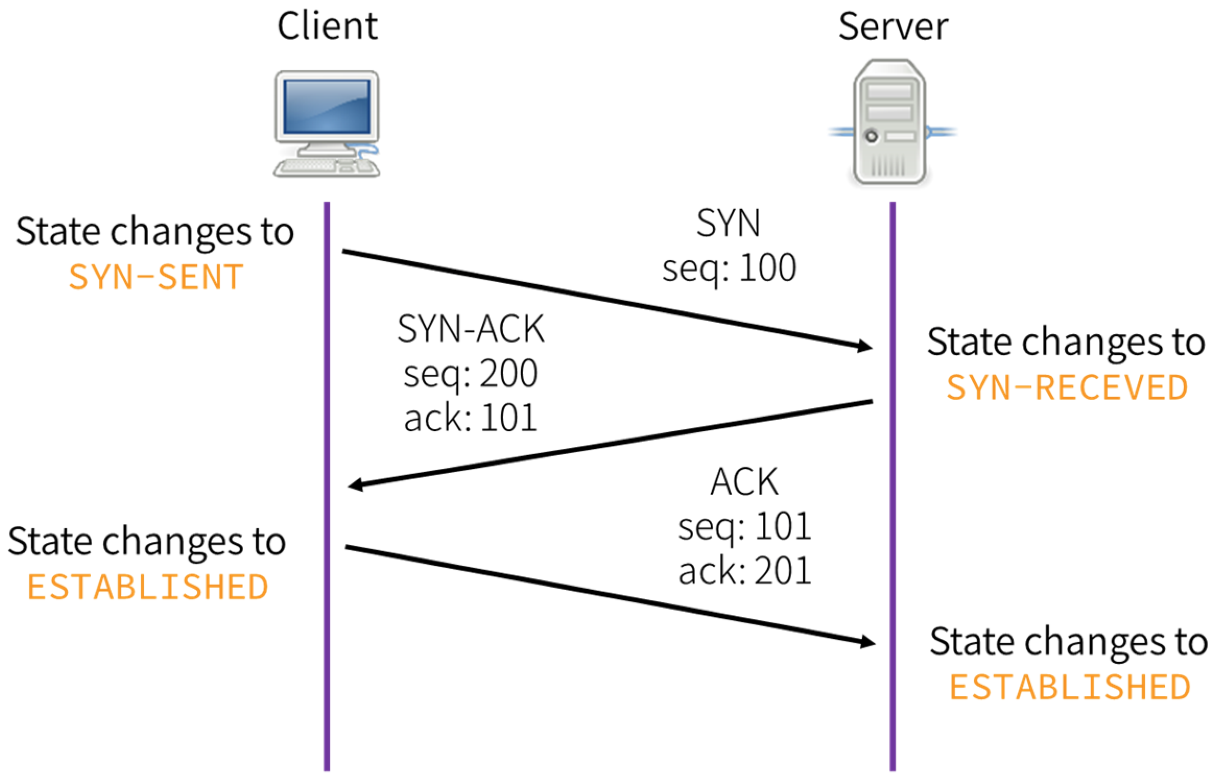
TCP Connection Establishment

Slide 5
When/Why use UDP?
Notes:
UDP is a much faster protocol, so programs which require the sending of a large amount of data (often when old data not being received will not change anything) often use this protocol. It is very commonly used in VoIP and game services.

Slide 6
Network Address Translation (NAT)
The reason IPv4 is still prominent, this system allows you to seperate internal private networks (and address spaces) from the public internet (and the global IP address space).
Your internal network which lives behind NAT enabled router(s) usually uses a private network range such as 10.0.0.0/8, 172.16.0.0/16, or 192.168.0.0/16*
The entire internal private network is then referenced by one or a small number of public (globally unique) IP addresses, with NAT performing the function of multiplexing the usage of the IP addresses
NAT has two primary benefits: (1) it allows for a huge savings in IP addresses a company needs to purchase and (2) it helps to hide your network topology as individual hosts cannot be directly contacted over IP
Notes:
Technically the class C network 192.168.0.0 should be /24 but because of the prevalence of CIDR notation it is usually /16 netmasked.

Slide 7
NAT Types
Static NAT: a pool of public IP addresses are assigned to the NAT appliance and those IPs are statically assigned to IPs in the private network. This is typically done for servers which are required to have the same IP address
Dynamic NAT: a pool of public IP addresses are assigned to the NAT appliance, and traffic which is leaving the private network is temporarily assigned an IP address from the pool until it’s request is responded to, then it relinquishes that address until making another request, at which point when making another request it might receive a different public IP address

Slide 8
NAT Types
Port Address Translation (PAT): a single public IP address is assigned to a NAT appliance and the translation is based on the combination of the private IP address and the source port
That combination is stored in the NAT appliance and the packet is re-encapsulated with the public IP address (so the responder can respond to a globally unique IP address) and a unique* source port (the destination port remains unchanged so the packet can still be processed correctly)
When a response is sent to the public IP address, the destination port (which was set uniquely* by the NAT appliance) is inspected and based on the logged private IP address and port for that unique* port it is re-encapsulated for the private network

Slide 9
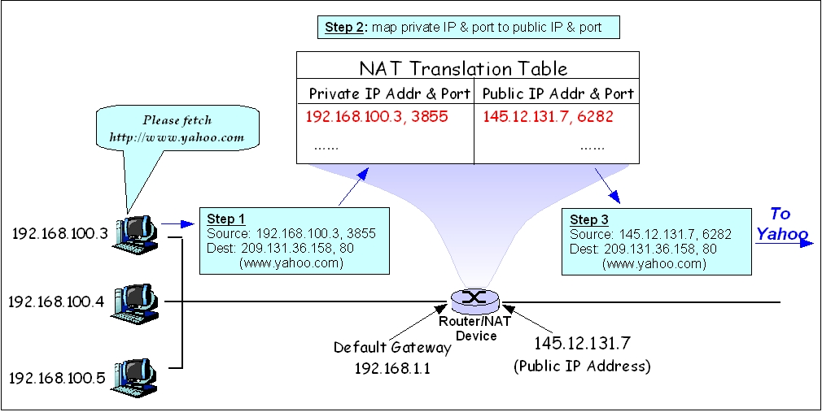

Slide 10
Questions?

Slide 11
Additional Resources
NAT - Current network security features used today

